Slide 1
Lab 2
Cindy J. Pang
Lab 1B, MWF 12:00-12:50pm
Week 2 – August 12, 2024

Slide 2
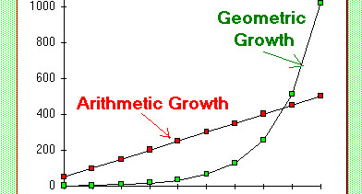

Lab 2 – Computer Exercise
For Question 6, use =GEOMEAN(array)
When is it appropriate to use a geometric mean over an arithmetic mean?
When you are dealing with exponential data, or when observations are dependent (not independent)
Example: bacterial growth
Geometric Mean Equation:
$$\sqrt[n]{x_{1}x_{2}⋅⋅⋅x_{n}}={\left(\prod_{i=i}^{n}{x_{i}}\right)}^{1/n}$$
Arithmetic Mean Equation:
$${\frac{1}{n}(x}_{1}+x_{2}+…+x_{n})=\frac{1}{n}\sum_{\left\{i=1\right\}}^{n}{x_{i}}$$

Slide 3
Lab 2 – Competency Assessment
Statistic vs Parameter
Observational vs Experimental Study
Retrospective vs Prospective Study
Causal vs Associative

Slide 4
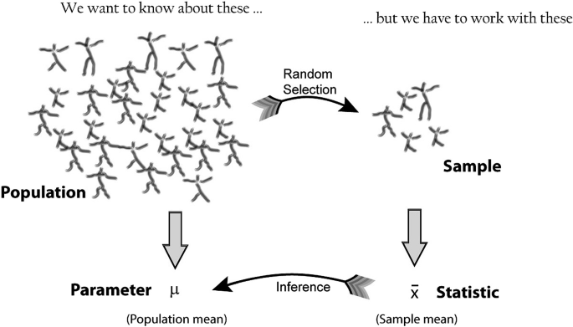
Statistics vs. Parameter
a Statistic is a measurement of the Sample
A Parameter is a measurement of the Population

Slide 5
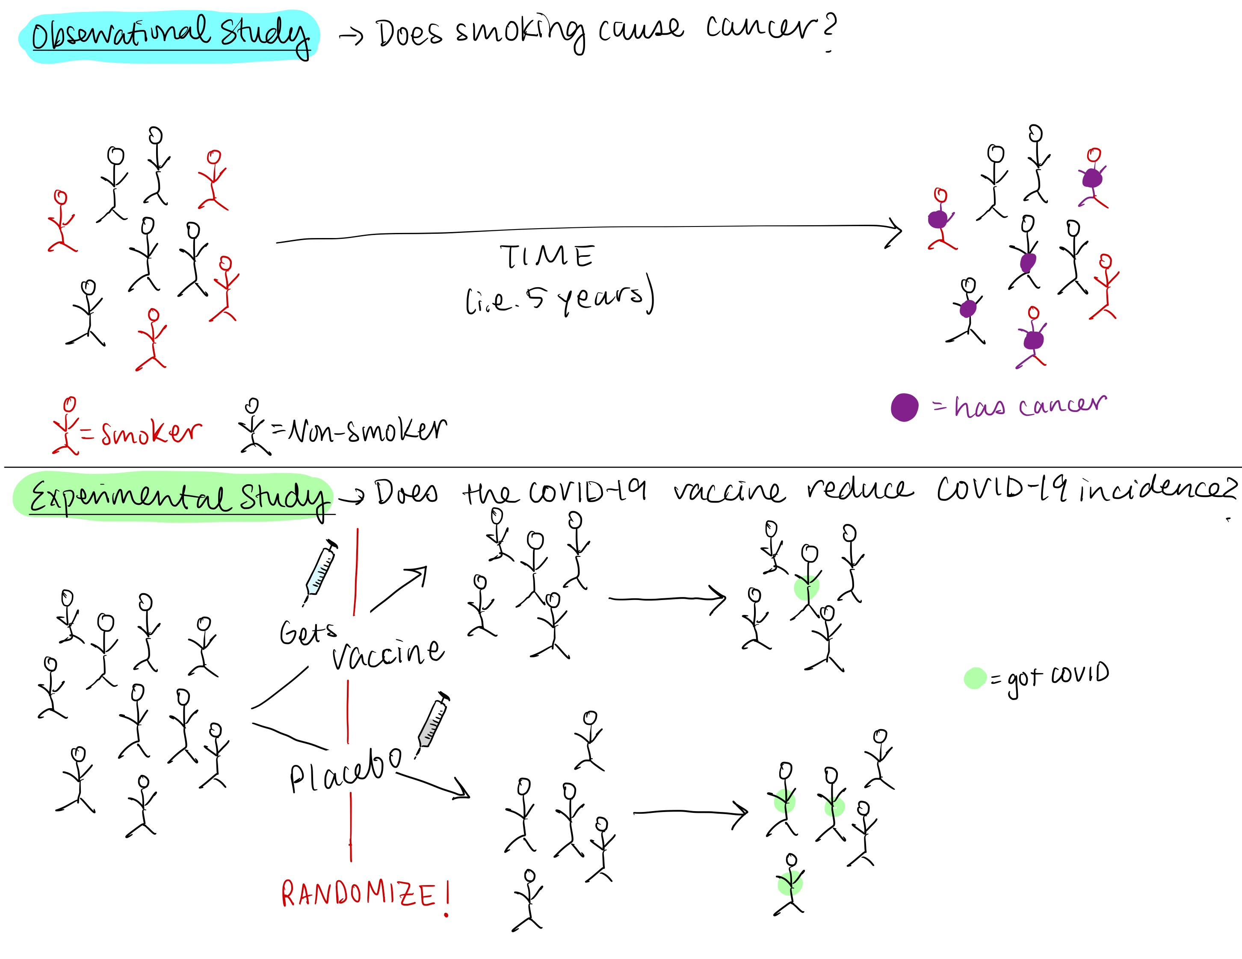
Observational vs. Experimental Study
In an Observational study you DO NOT intervene with the subjects
Generally, there is no control group (exception: Case-Control studies)
High external validity → reflects the behavior of the population well
Example: cohort studies where subjects are followed for a defined period, Case-Control studies
In an Experimental Study there IS AN INTERVENTION with the subjects
Example: Randomized Control Trials (RCT)
Experimental Studies are great at assessing causality since you can control for variables

Slide 6
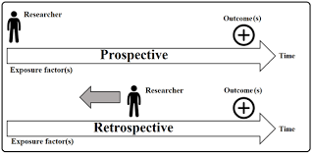
Retrospective vs. Prospective Study
In a Retrospective Study the event of interest has already happened
You are interested in a PAST event
In a Prospective Study, the event of interest has not happened yet
You are interested in a FUTURE event

Slide 7
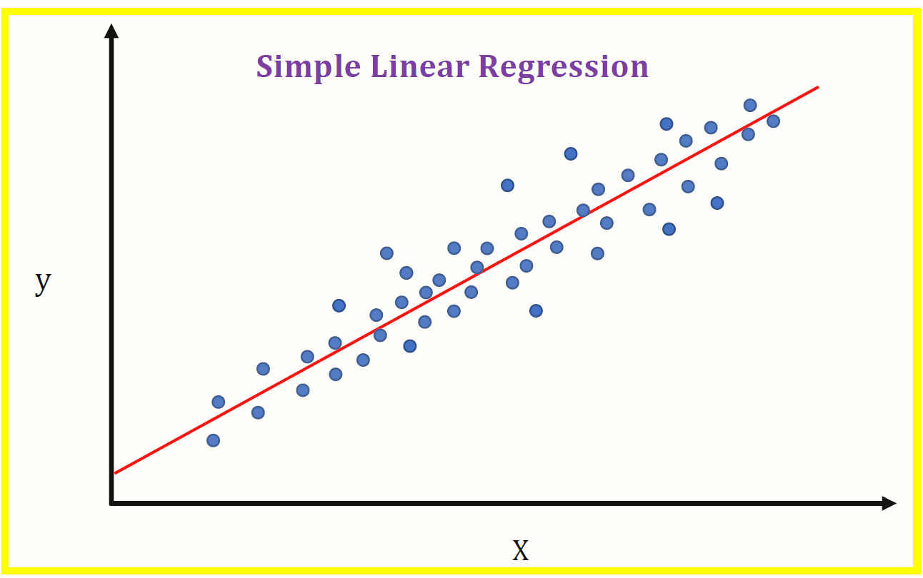

Causal vs. Associative (Correlation)
To have an association, there is a relationship between your variables
Oftentimes, this relationship looks like a simple linear regression between two variables
Or, let’s consider the relationship between the sun rising in the morning and the rooster yelling!

Slide 8
Causal vs. Associative (Correlation)
The sun rises and the rooster crows
But that does not imply that the sun causes the rooster to crow or the crow to cause the sun to rise…

Slide 9
Causal vs. Associative (Correlation)
CAUSATION IS NOT CORRELATION!!!!

Slide 10
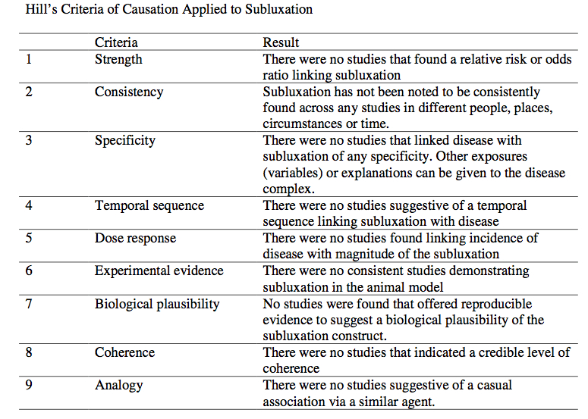
Causation is harder to claim than correlation.
You will need to be able to control for your variables (ex. Randomized Control Trials)
There are many scientists who have worked on solving how to claim causality between variables:
Sir Bradford Hill’s Criteria
Granger Causality
Causal Diagrams (DAGs)
Etc.

